Slide 1
Spying On Your Application
How To Be a Super Sleuth Tester

Slide 2

New slides, who dis?
Hilary Weaver-Robb
Software Quality Architect
Detroit, MI, USA

Slide 3

https://tinyurl.com/yzlqkvz7
Super Early Bird prices end on January 24th!

Slide 4
Objective
Introduce Browser Developer Tools
Why they are helpful
How to find them in various browsers

Slide 5
Objective BORING! 😴😴😴
Introduce Browser Developer Tools
Why they are helpful
How to find them in various browsers

Slide 6
The Brief
Something’s missing…
This button is useless!
We’ve got mobile users now, oh no!

Slide 7
But First!
Tools of the Trade

Slide 8

Lots of other cool stuff!
Elements
Sources
Console
https://pngtree.com/freepng/detective-tools_3251231.html
Network

Slide 9
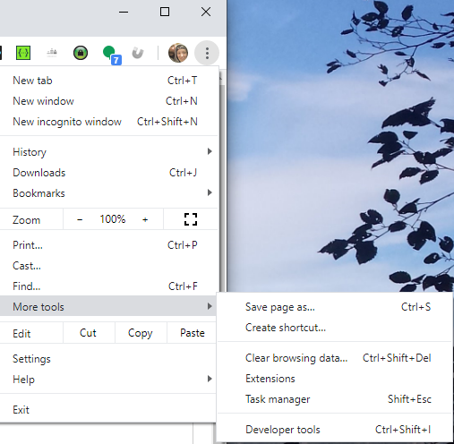
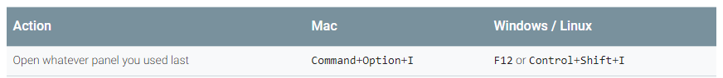
Dev Tools

Slide 10
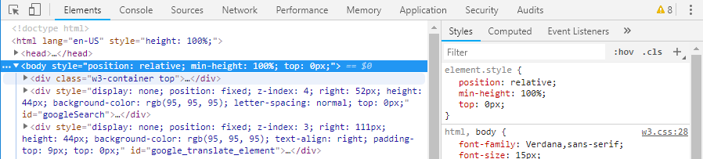



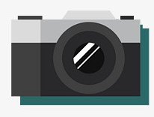
Dev Tools
Elements
Console
Sources
Network

Slide 11
The Case of The Missing Dog
When the UI isn’t giving us any clues, we need to head to Dev Tools!

Slide 12

Case File
Cooper is missing!
What could be the culprit?
New image slider was implemented
JavaScript
Images exist on the server

Slide 13
Spy Tools – Console
JavaScript errors
Some network errors

Slide 14
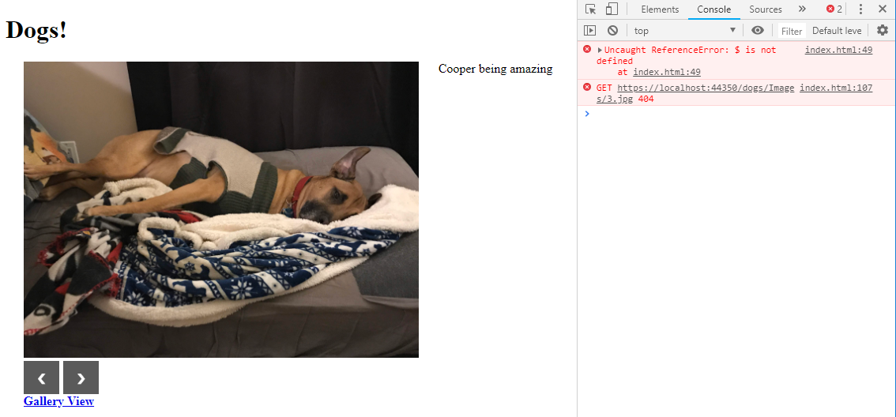
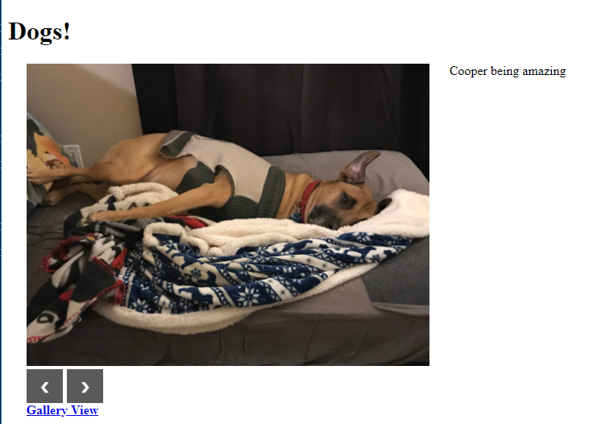
Spy Tools – Console

Slide 15
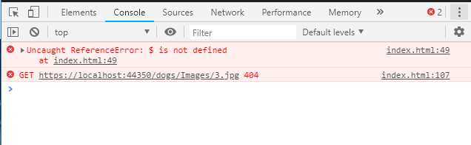
Spy Tools – Console

Slide 16
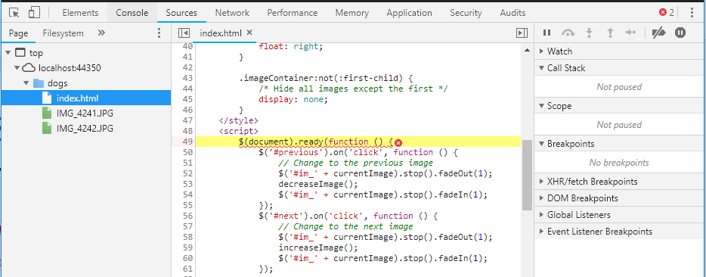
Spy Tools – Console -> Sources

Slide 17
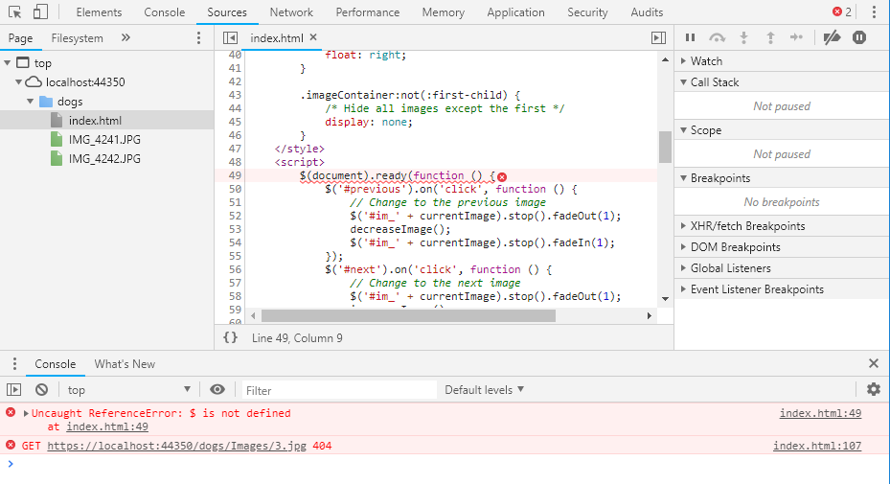
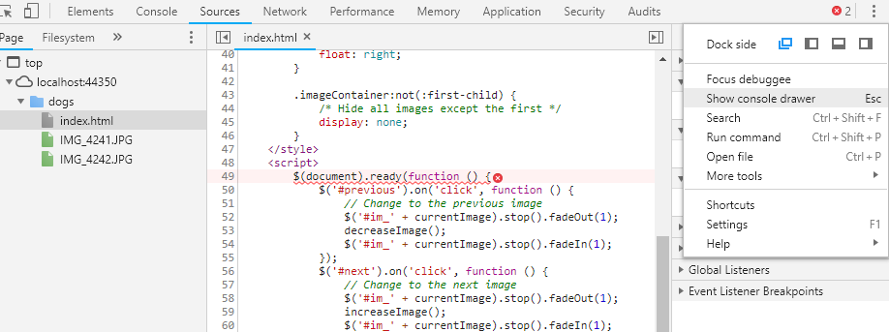
Spy Tools – Console -> Sources

Slide 18
Spy Tools – Network
Calls the application makes
To itself
To other services and applications

Slide 19
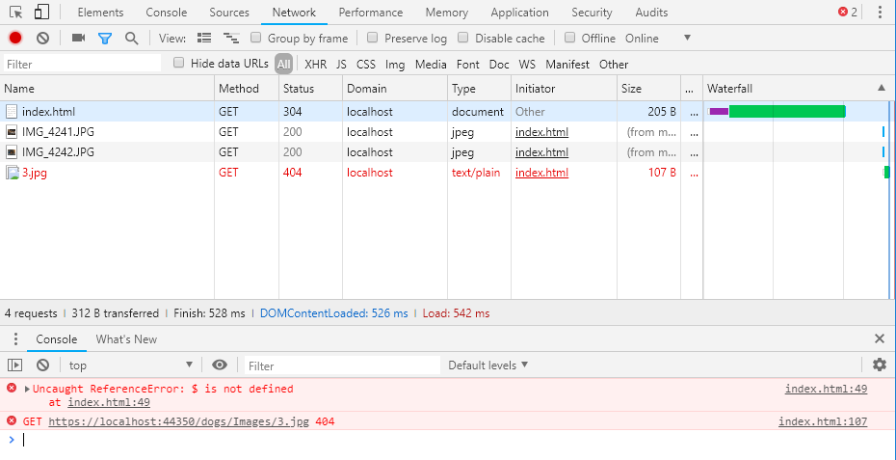
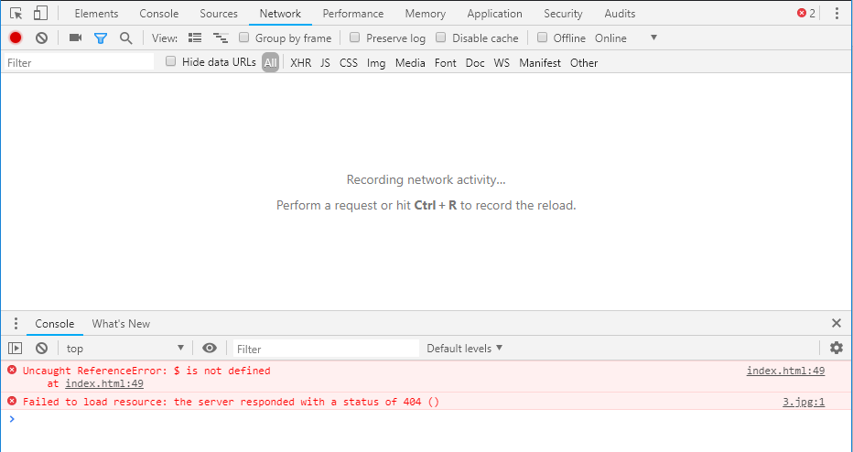
Spy Tools – Network

Slide 20
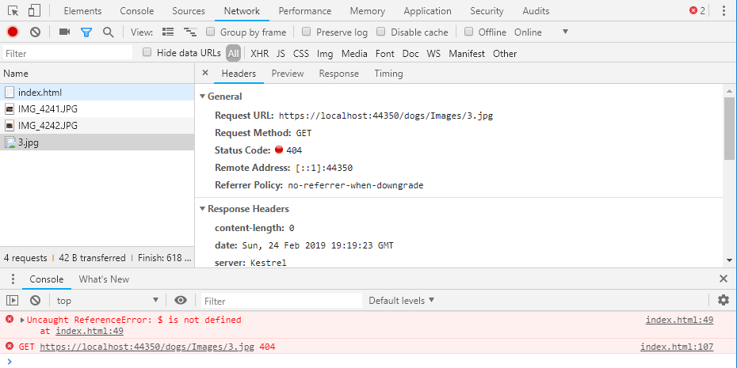
Spy Tools – Network

Slide 21
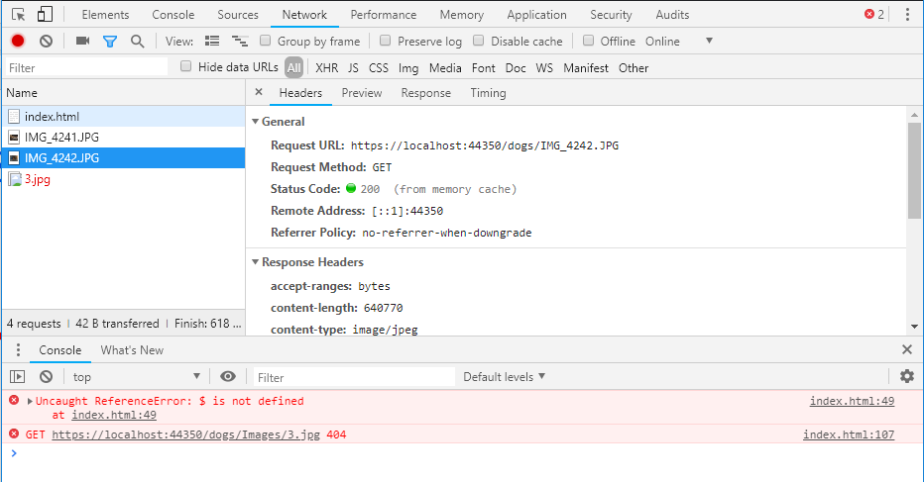
Spy Tools – Network

Slide 22
Spy Tools – Network

Slide 23
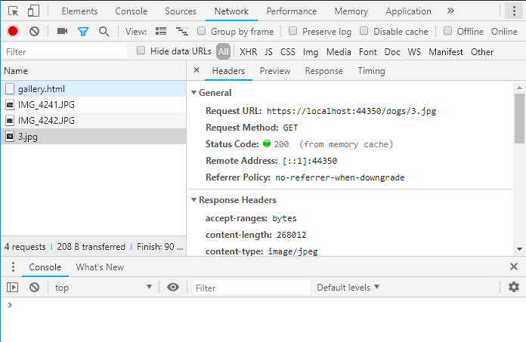
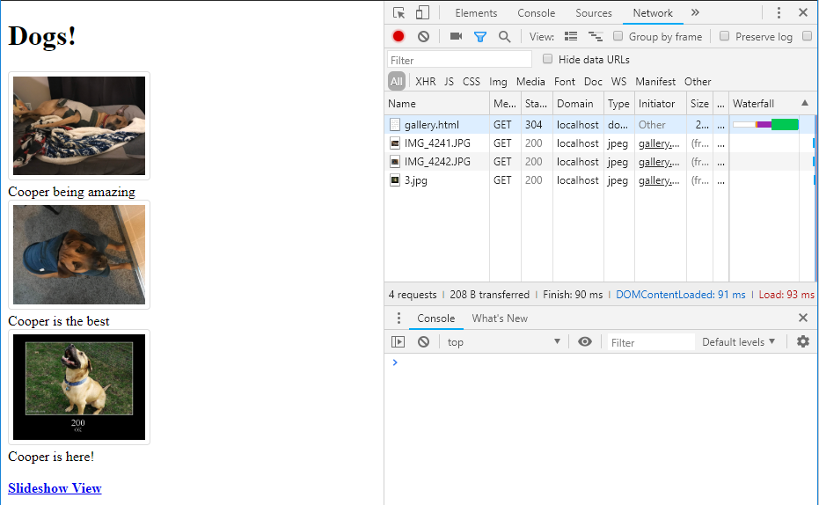
Spy Tools – Network

Slide 24
The Case of The Useless Button
When buttons aren’t working, Dev Tools has the answers!

Slide 25
Case File
Slideshow button isn’t working ☹
What could be the culprit?
JavaScript
Button isn’t linked properly to the JavaScript?

Slide 26
Spy Tools – Elements
Inspect and edit HTML and CSS
View how JavaScript affects the DOM

Slide 27
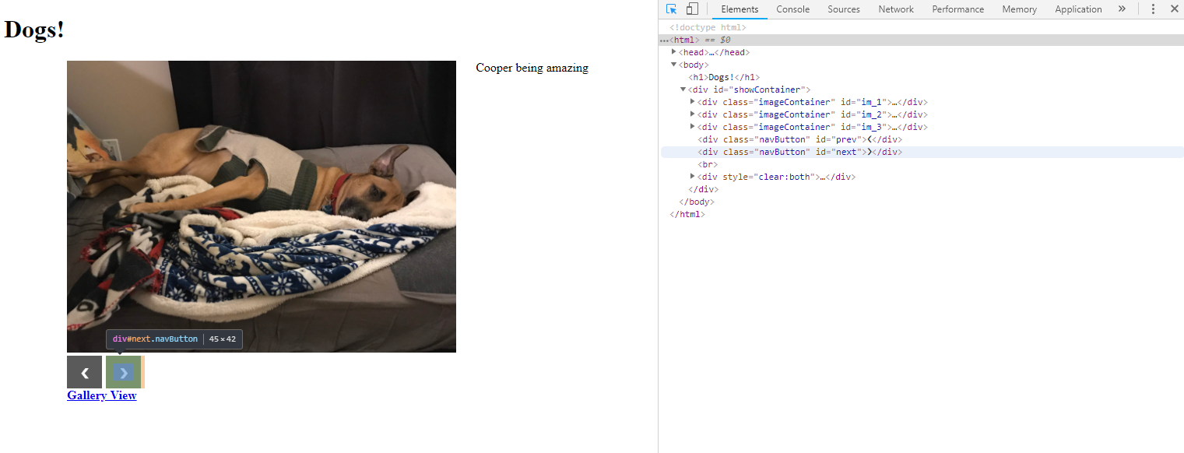
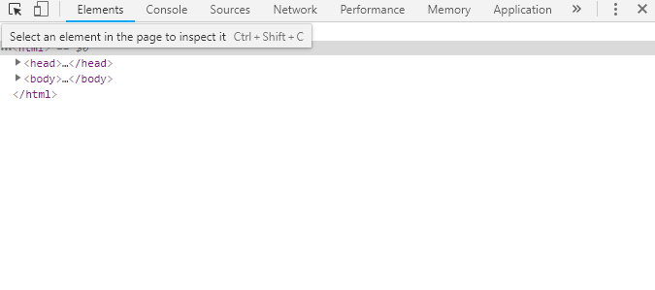
Spy Tools – Elements

Slide 28
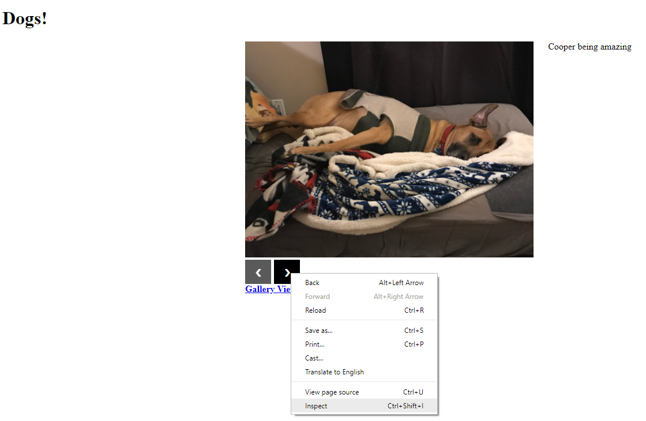
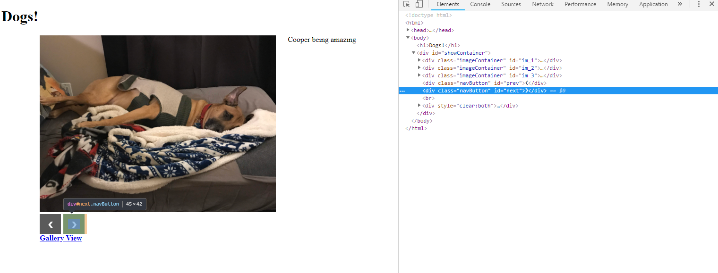
Spy Tools – Elements

Slide 29
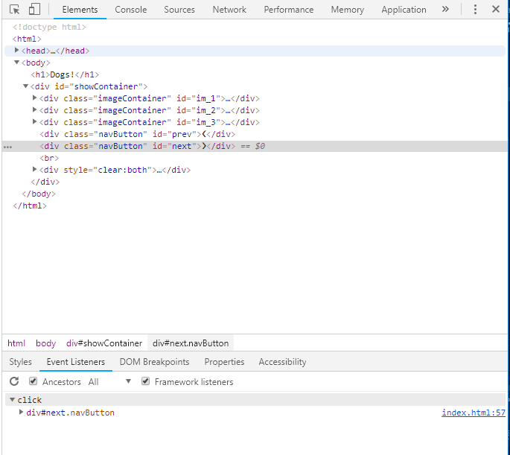
Spy Tools – Elements

Slide 30
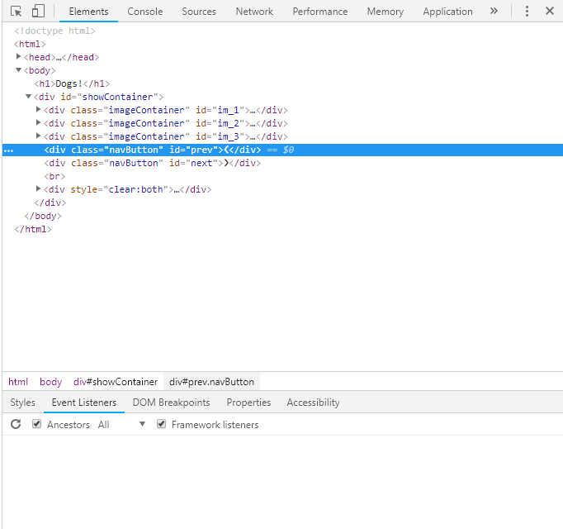
Spy Tools – Elements

Slide 31
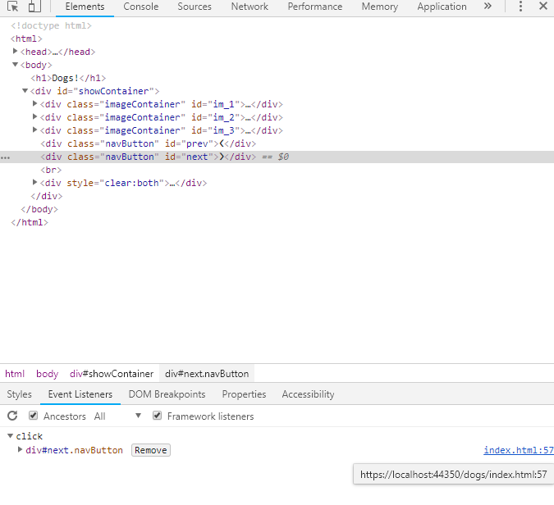
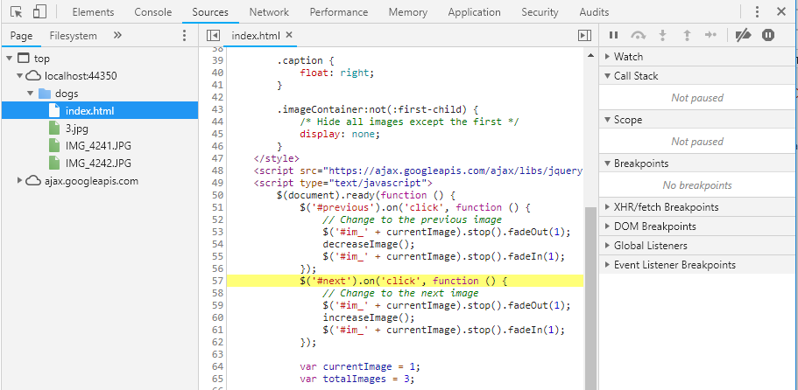
Spy Tools – Elements -> Sources

Slide 32
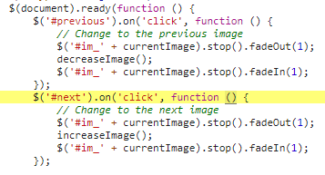
Spy Tools – Sources

Slide 33
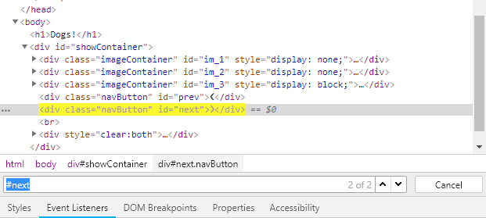
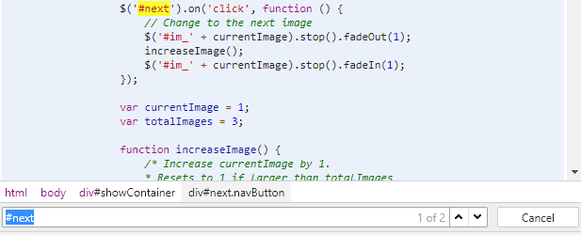
Spy Tools – Elements

Slide 34
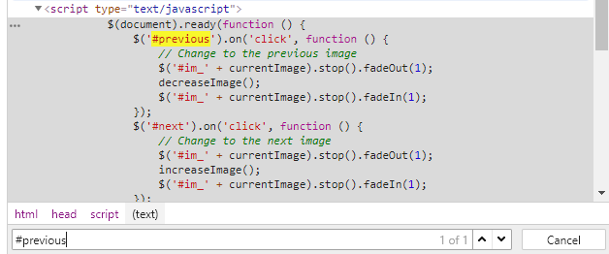
Spy Tools – Elements

Slide 35
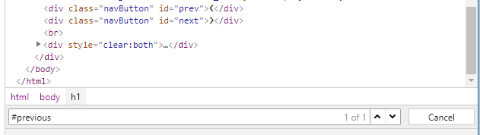
Spy Tools – Elements

Slide 36
The Case of The Shrinking Screens
When our users complain about our site on mobile, Dev Tools can help us repro!

Slide 37
Case File
Mobile users can’t get back to Gallery View
What could be the culprit?
Missing link?
Not responsive?

Slide 38

Spy Tools – Device Toolbar
View your site in pre-defined sizes
Device emulators

Slide 39
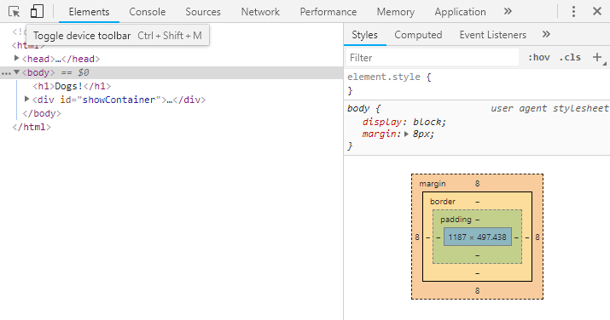
Spy Tools – Device Toolbar

Slide 40
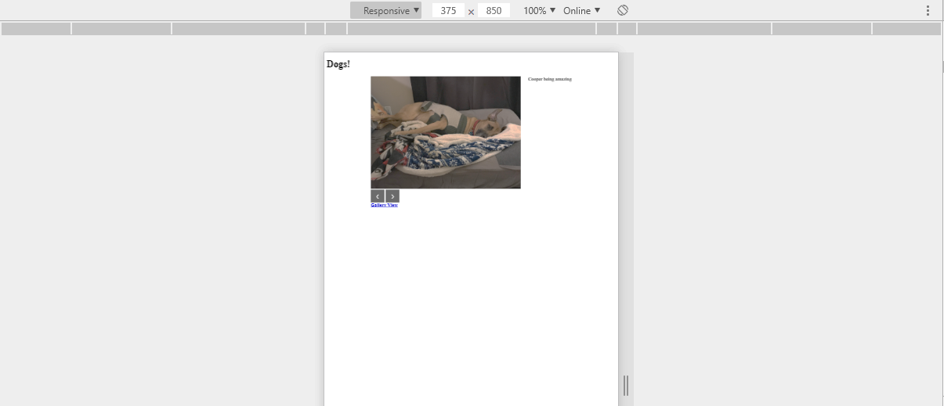
Spy Tools – Device Toolbar

Slide 41
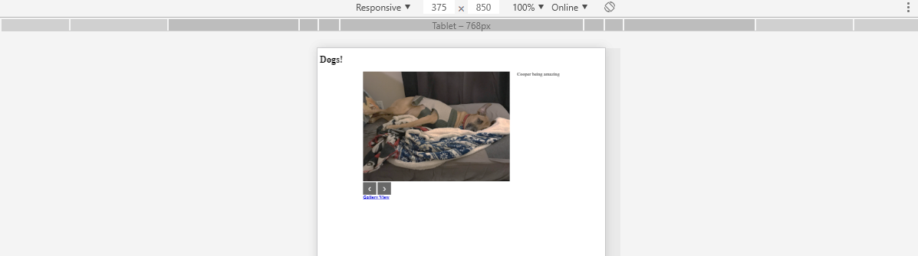
Spy Tools – Device Toolbar

Slide 42
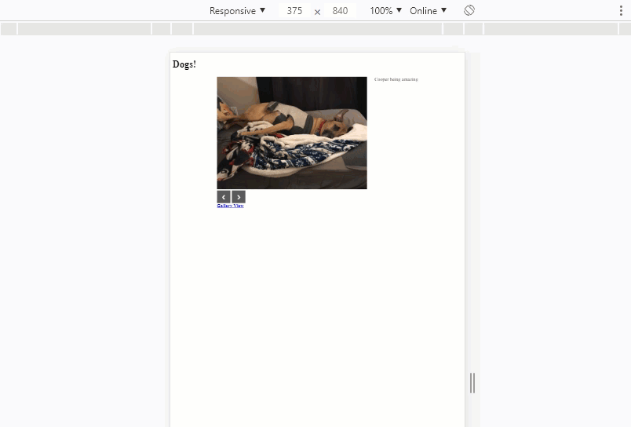
Spy Tools – Device Toolbar

Slide 43
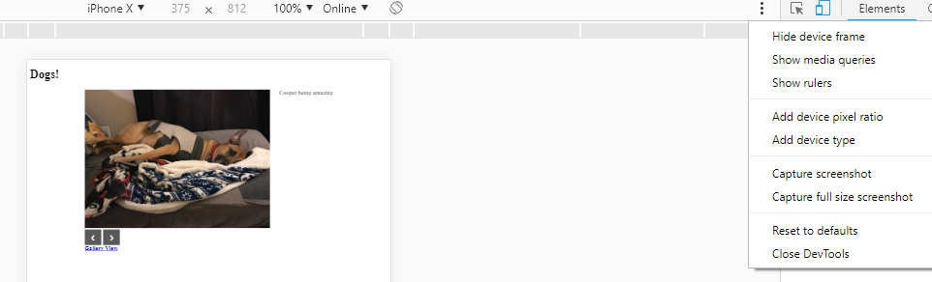
Spy Tools – Device Toolbar

Slide 44
Spy Tools – Audit
Performance
Accessibility (a11y)
User experience (UX)

Slide 45
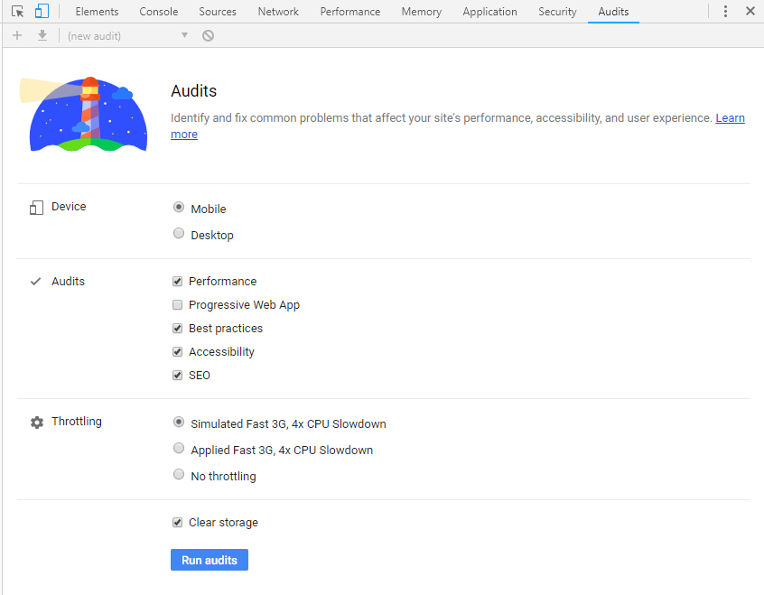
Spy Tools – Audit

Slide 46
Spy Tools – Audit

Slide 47
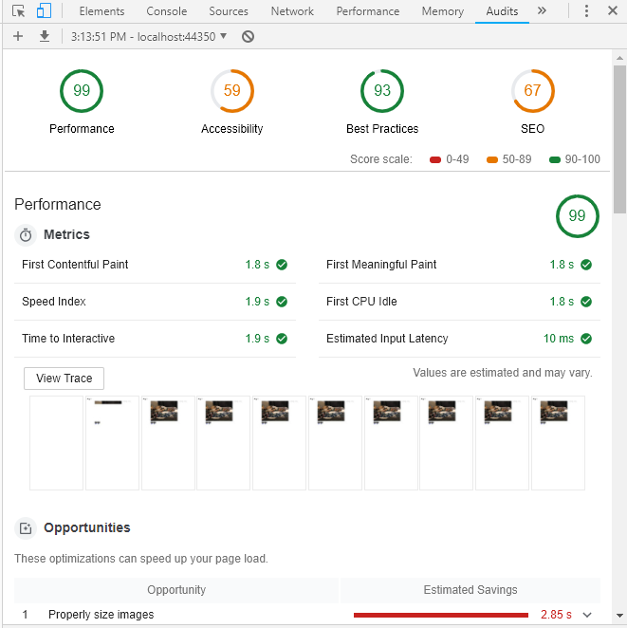
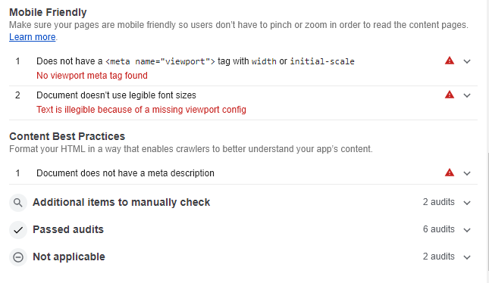
Spy Tools – Audit

Slide 48
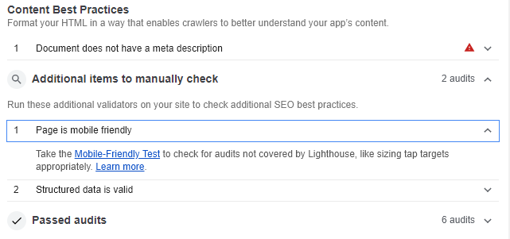
Spy Tools – Audit

Slide 49
Other Spy Tools
Dev tools is super cool

Slide 50
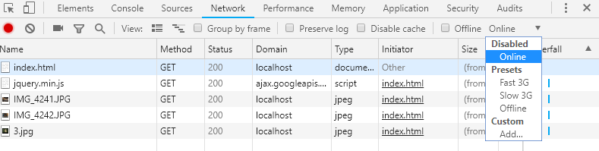
Spy Tools – Other Tools

Slide 51
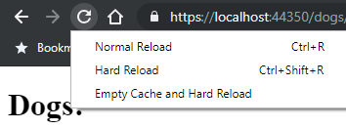
Spy Tools – Other Tools

Slide 52
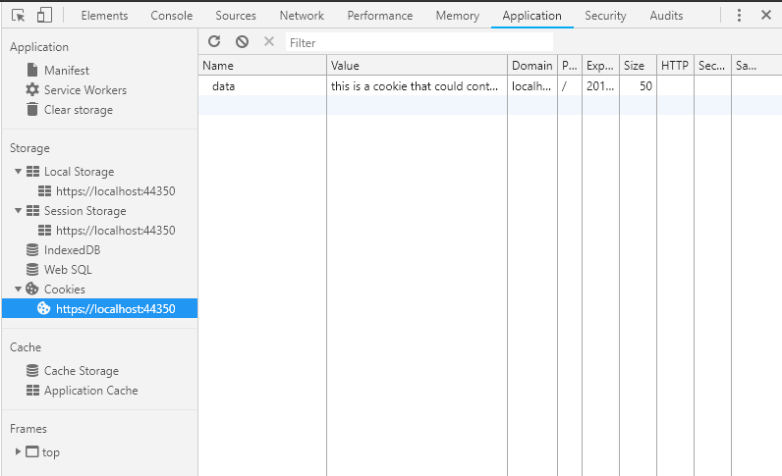
Spy Tools – Other Tools

Slide 53
And so much more!

Slide 54
Debrief
JavaScript errors
Console
Sources
404 errors (missing files)
Network
Nonfunctional buttons
Elements
Sources
Mobile capability
Device Toolbar
Audits

Slide 55



Resources
@ChromeDevTools
@FirefoxDevTools
Devtools.chrome.com
Anti-code.com/devtools-cheatsheet
@coopamoose
g33klady/Dogs_devtools

Slide 56
Questions?

